Slide 1

Pengembangan Kurikulum Mata
Kuliah Pemograman Teknik Informatika PENS
Focus group discussion online
July, 04th 2020

Slide 2





People behind the scene
Insert photo here
Insert photo here
Insert photo here
Insert photo here
Insert photo here
M. Rizki Dzulkarnain
Irsal Shabirin
Rizal A. Pambudi
Hendra Prasetio
Amin Endah S.
Android Engineer
Tiket
Mobile Engineer
Bukalapak
Frontend Engineer
Bukalapak
Backend Engineer
Tokopedia
Data Scientist
Bank Indonesia

Slide 3
“
What are we going to talk today?
Programming and data, perhaps?
01
Mobile apps developer
02
Frontend engineer
03
Backend engineer
04
Data scientist
05
Discussion
“

Slide 4
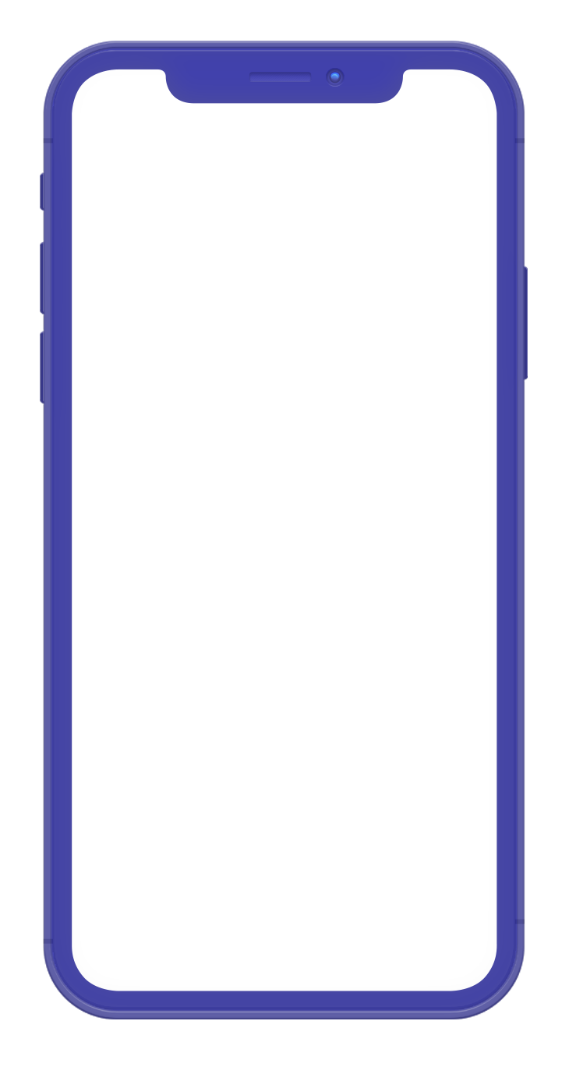

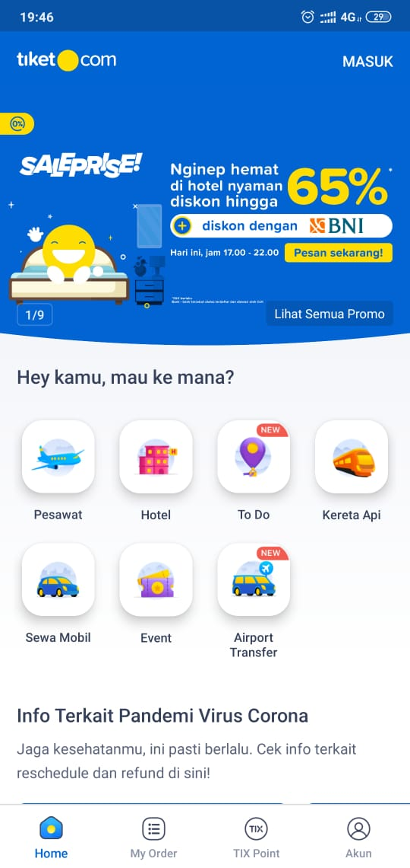
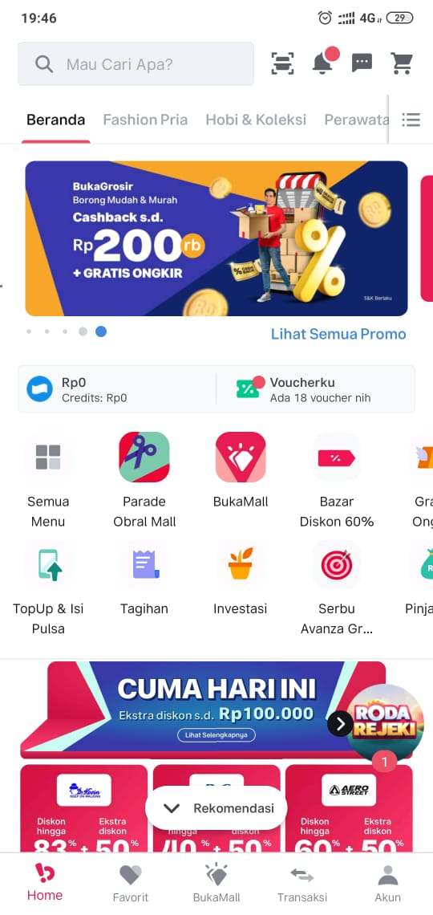
Mobile Apps
Development
ANDROID
IOS
HYBRID
(react native, flutter, xamarin)

Slide 5

*
Need to Prepare
Clean Architecture
Pattern Design
Programming Language
ANDROID DEVELOPMENT

Slide 6
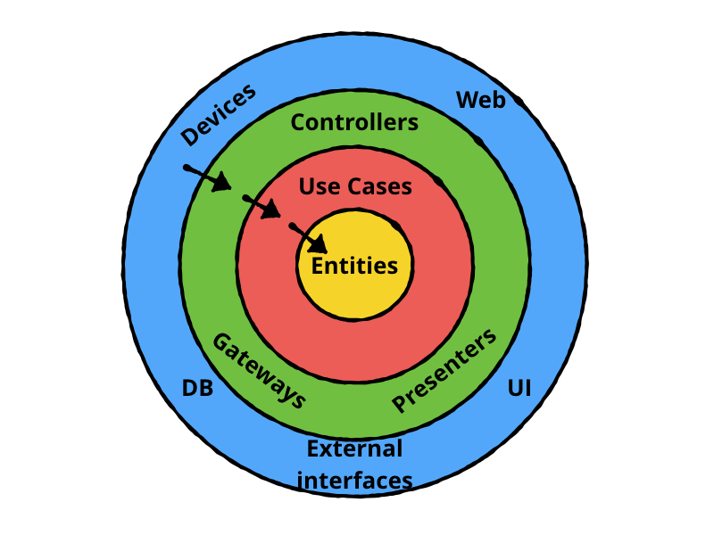
Clean Architecture
Data layer (Network data source, Disk data source)
Domain layer (Entities/Models, Use Cases, Business logic)
Presentation layer (Activities, Fragments, UI logic)
source : https://www.raywenderlich.com/3595916-clean-architecture-tutorial-for-android-getting-started

Slide 7
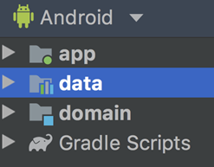
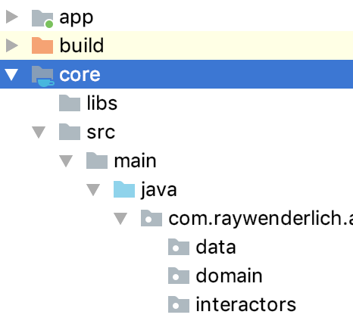
Illustration

Slide 8
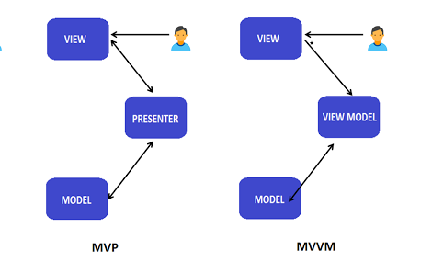
Pattern Design
MVP (Model-View-Presenter)
The MVP pattern separates the data model, from a view through a presenter.
MVVM (Model-View-ViewModel)
The MVVM allows automatic of changes, inside the state of View-Model to the View. Generally, the View-Model utilizes the observer pattern to inform changes in the View-Model to the Model.
Notes:
Keunggulan mvvm menggunakan live data dan view model karena sudah disupport oleh android jetpack yang merupakan kolaborasi antara google dengan jetbrains. Kelebihannya juga lifecycle aware oncleared.

Slide 9
Reactive Programming using LiveData
Observable
data stream that do some work and emits data.
Observer
receives the data emitted by Observable
Subscription
The bonding between Observable and Observer
Operator
Operators modifies the data emitted
Scheduler
the thread on which observable emit the data or observer receives data
Scheduler.io
Scheduler.mainThread
Scheduler.computation

Slide 10
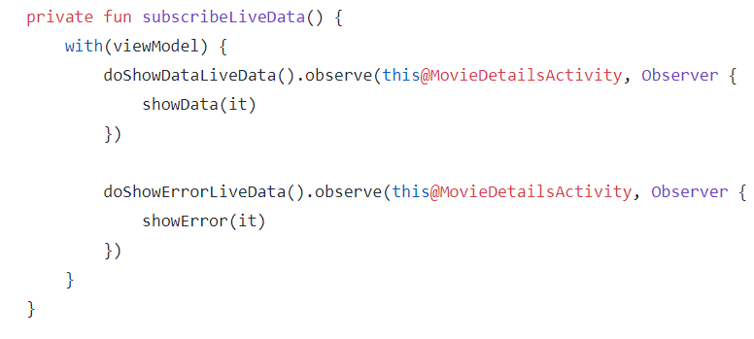
MVVM
view
subscription
Observer

Slide 11
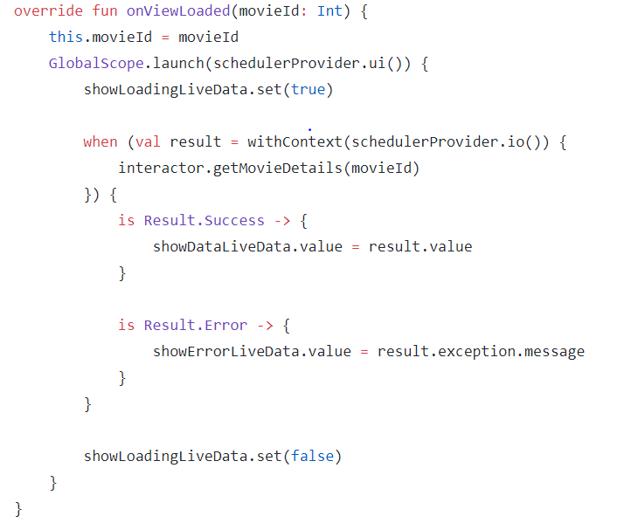
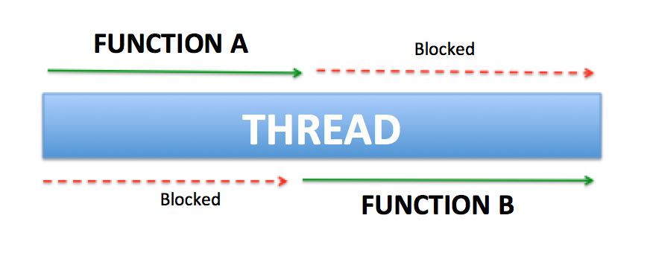
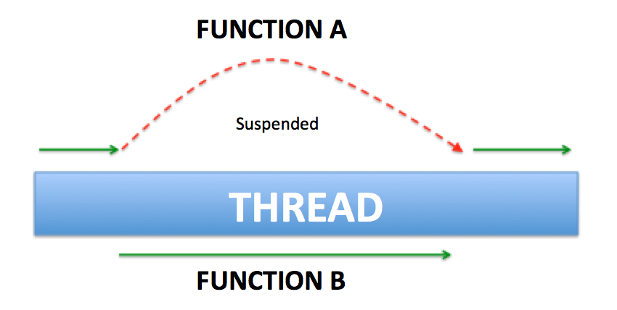
viewmodel & Threading kotlin coroutines
Scheduler
Observable

Slide 12
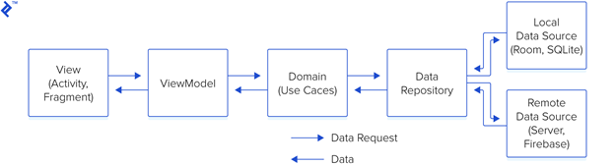
END TO END FLOW & LIBRARIES
viewparam
entitiy
Library:
Dependecy Injection
(Dagger, Koin, Hilt) Reactive & Threading
(Live Data, Coroutines RxJava)
Library:
Unit test
(Junit, Mockito)
Library:
API Service
(Retrofit, OkHttpClient, Ksoap)
Notes:
Fungsi DI untuk memudahkan unit test, fleksibel terhadap perubahan class intance, implement singleton

Slide 13
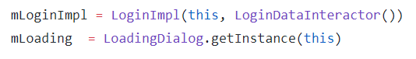
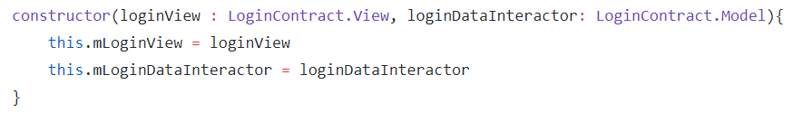
MVP
view
presenter
MVVM
view
subscription
Observer

Slide 14
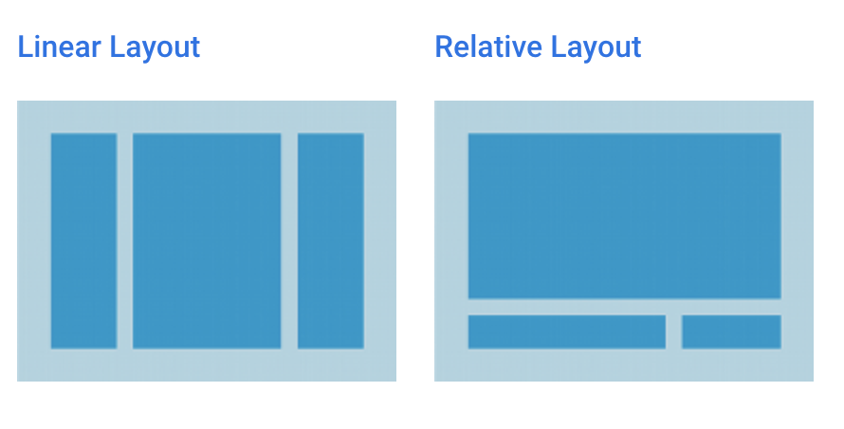
Android Programming Language
XML layout for design layout
using Kotlin /Java Code (Anko)
Which is better ?
Image credit : https://developer.android.com/guide/topics/ui/declaring-layout
Notes:
Tapi dibukalapak jarang pakai XML, langsung pakai Kotlin.
Which is ? Jaksel ?
Buat belajar, tetap xml paling baik, krn ada Viewer nya
Buat performance, boleh pakai kode.
Masih inget waktu pertama kali diajari android oleh bu Yuliana…. Masih pakai Eclipse, Android nya masih Gingerbread.

Slide 15
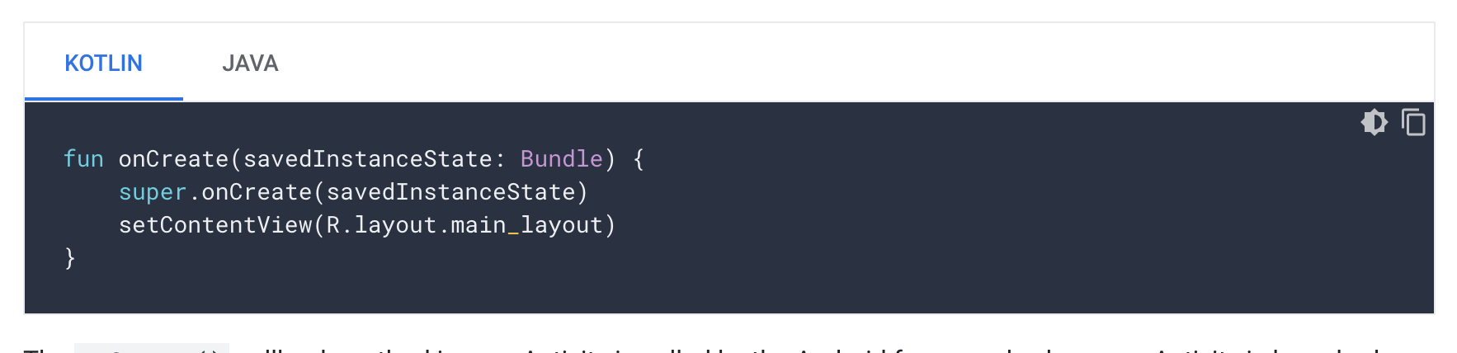
Android Programming Language
When we start to learn about Android. Start from Kotlin or Java ?
Image credit : https://developer.android.com/guide/topics/ui/declaring-layout
Notes:
Kotlin jadi tab pertama waktu baca kode dokumentasi dr Google ?. Artinya Google sangat menyarankan menggunakan Kotlin ?
Bukalapak sdh 83.7% kotlin
Java masih menjadi tulang punggung di Android. Sehingga utk awal, masih OK utk belajar.

Slide 16
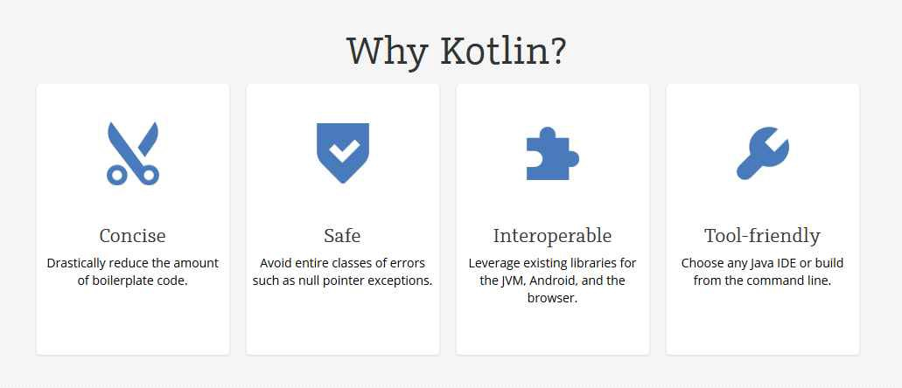
Android Programming Language
Image credit : https://hackernoon.com/java-vs-kotlin-its-time-to-expand-android-development-f08e3d6a72b6
Notes:
Concise = Ringkas

Slide 17
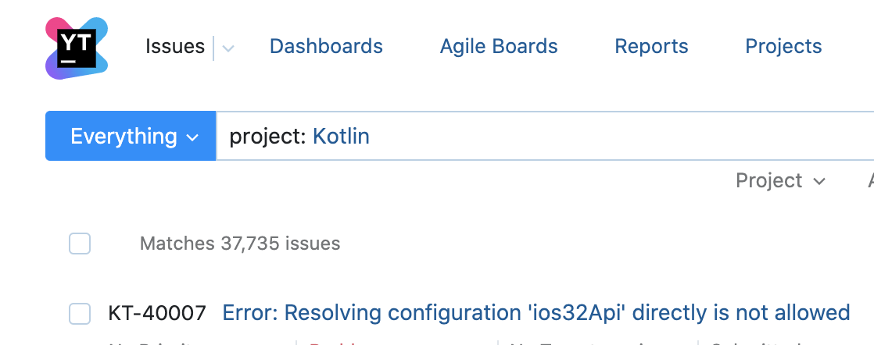
Android Programming Language
Cons of Kotlin ?
Fluctuating compilation speed
Image credit :https://youtrack.jetbrains.com/issues?q=project:%20Kotlin
Notes:
Kekurangan Kotlin.
Pengalaman ngedit file dengan jumlah line >= 15xx
Code Completion yang lama
Bukalapak_android total line of codes nya `1.647.xxx` (termasuk unit test)

Slide 18
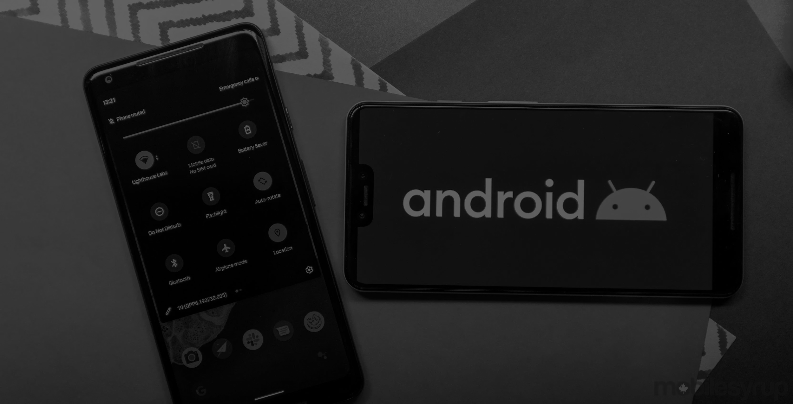
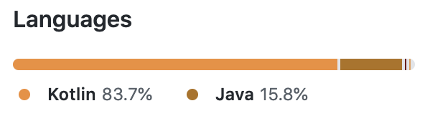
Need to Have
*
Java / Kotlin
Android Studio
Nice to Have
Environment (Git, GitHub/GitLab)
Dependency Manager (Gradle, Maven?)
Network (Retrofit, OkHttp, Volley, AsyncTask?, Gson)
Image Loader (Glide, Picasso, Fresco, Coil)
Unit Test (Robolectric, JUnit)
Android engineer
tech stack
Optional
Memory Management (LeakCanary)

Slide 19

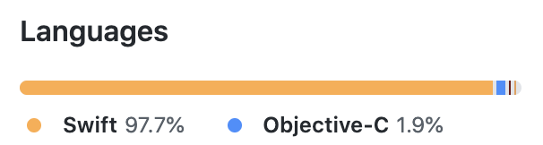
Need to Have
*
Swift / Objective C
MacOS
XCode
Nice to Have
Environment (Git, GitHub/GitLab)
Dependency Manager (CocoaPods, Carthage)
Network (Alamofire, Starscream, SwiftPhoenixClient)
Unit Test (Nimble, Mockingjay, Mockit)
Optional
iOS engineer
tech stack
Memory Management (MLeaksFinder)

Slide 20
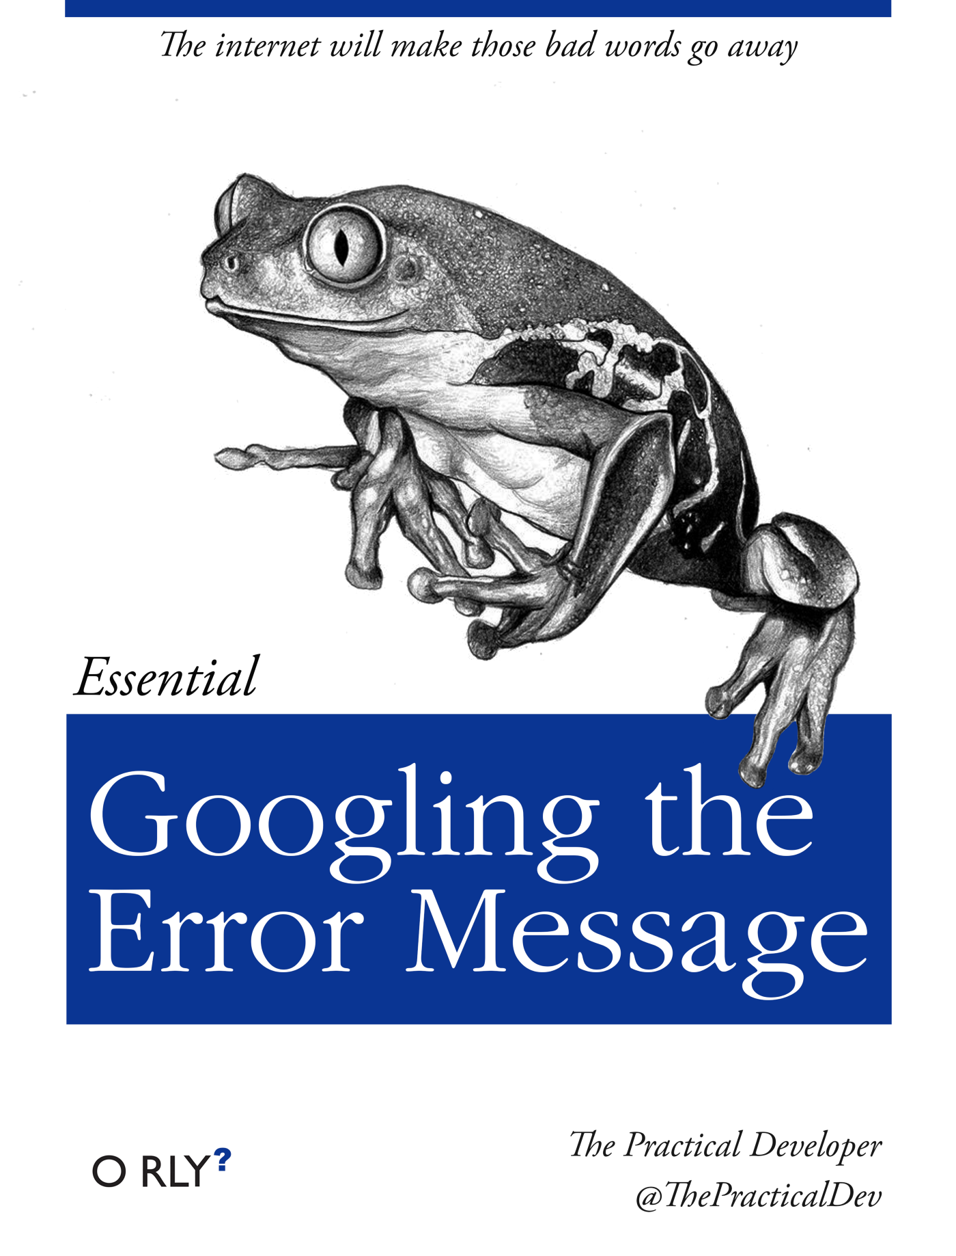
Learn Trending Tech Stack
By Keyword
“Awesome [android/ios/web/data] github”
“Roadmap [web/android/ios/data] github”
Image credit : https://github.com/thepracticaldev/orly-full-res

Slide 21
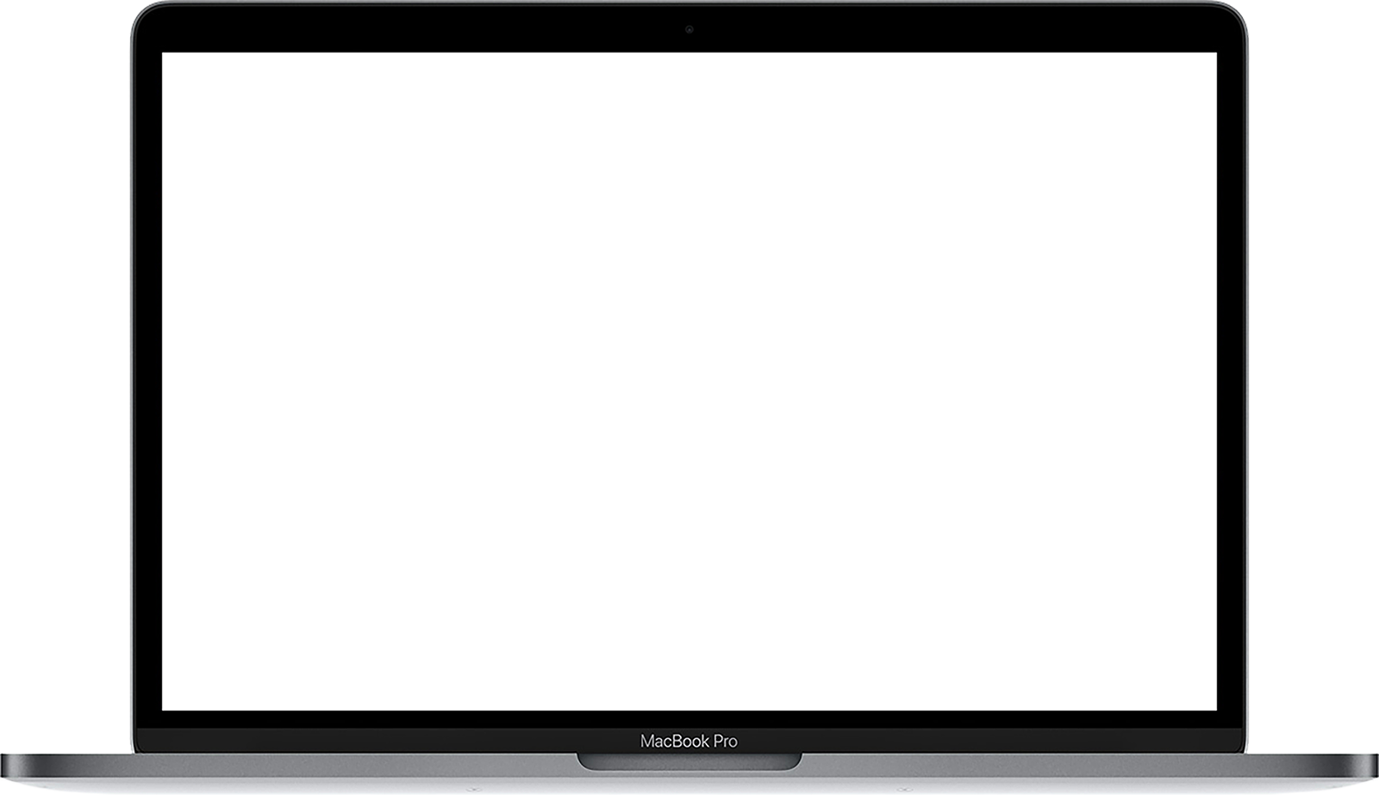

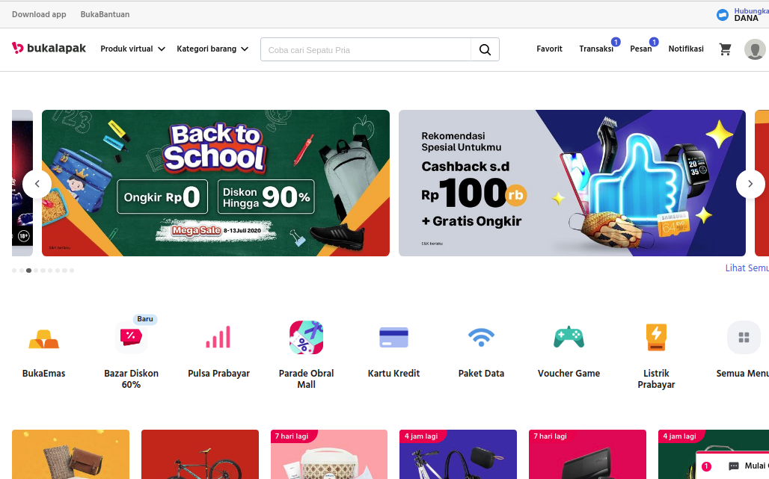
02
Frontend engineer
Handle user-facing for web platform (desktop or mobile website).
Developing feature to enhance the user experience.
Integrate with APIs developed by backend engineers

Slide 22


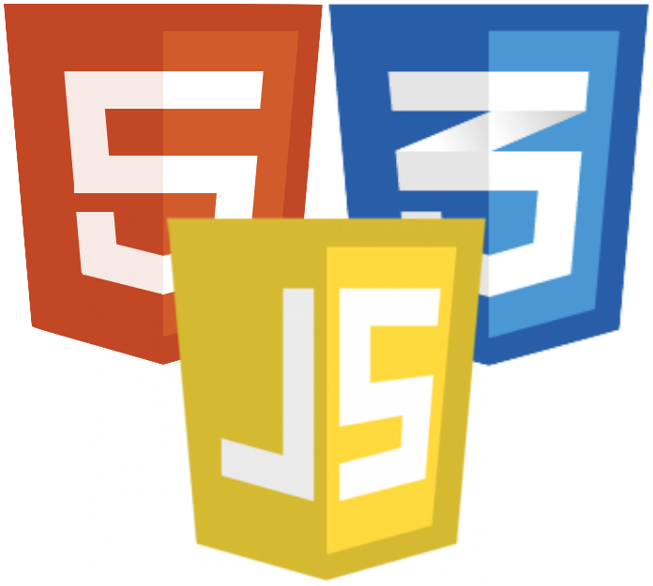





Need to Have
*
HTML + CSS
JavaScripts
- ECMAScript 6
- jQuery
- AJAX
Frontend
tech stack
Nice to Have
NodeJS
JS Framework
- React
- Vue
- Angular
CSS preprocessor
Optional
Unit test
- mocha
- vue-test-utils
SEO principles
How to be frontend engineer 101

Slide 23
Learning Hierarchy
Here are the progress of learning that can be done
HTML
Semantic HTML
Conventions & best practice
Form & validations
SEO Basics

Slide 24
Learning Hierarchy
Here are the progress of learning that can be done
CSS
Making layouts
Responsive design
Media queries

Slide 25
Learning Hierarchy
Here are the progress of learning that can be done
JS
Syntax & basic constructs
DOM manupulation
Fetch API / AJAX (XHR)
ES6+ & modular javascript

Slide 26
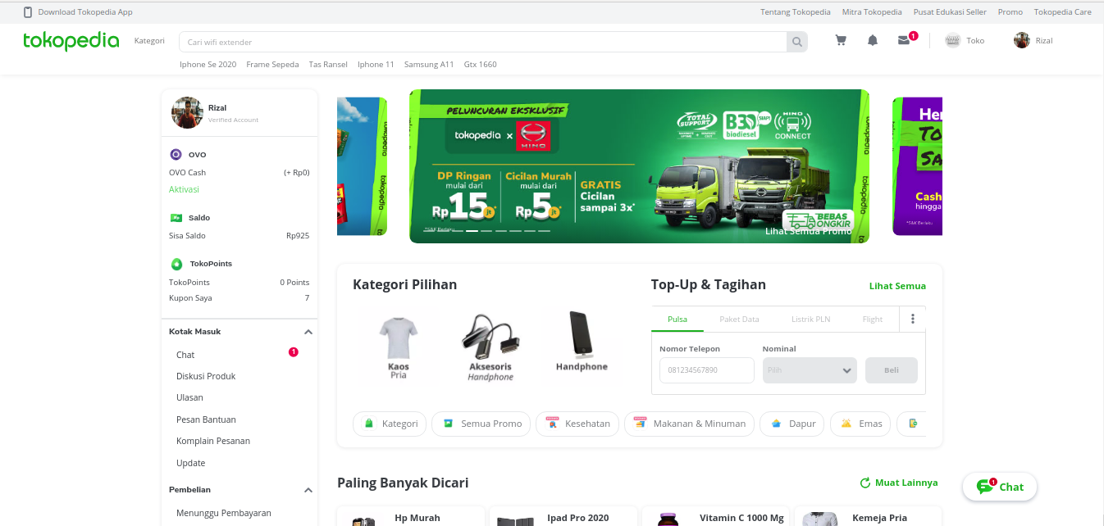
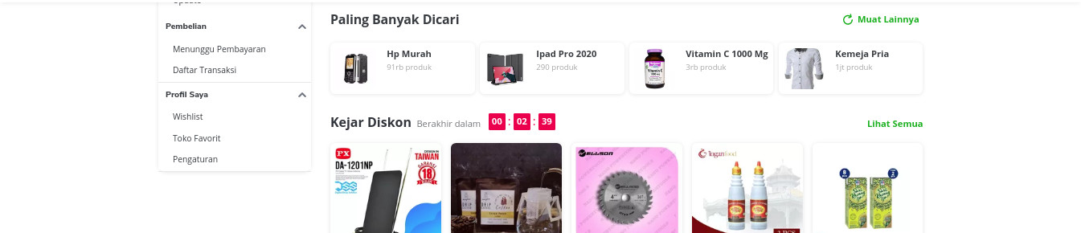
03
Backend engineer
Contribute to all aspects of the software development lifecycle including design, development, documentation, testing and operations
Work with your team to maintain, improve and clean your code
Deliver good quality code in a reasonable timeline

Slide 27
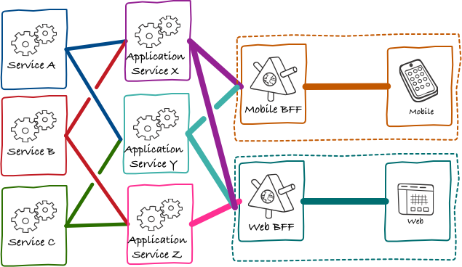
Backend Position

Slide 28
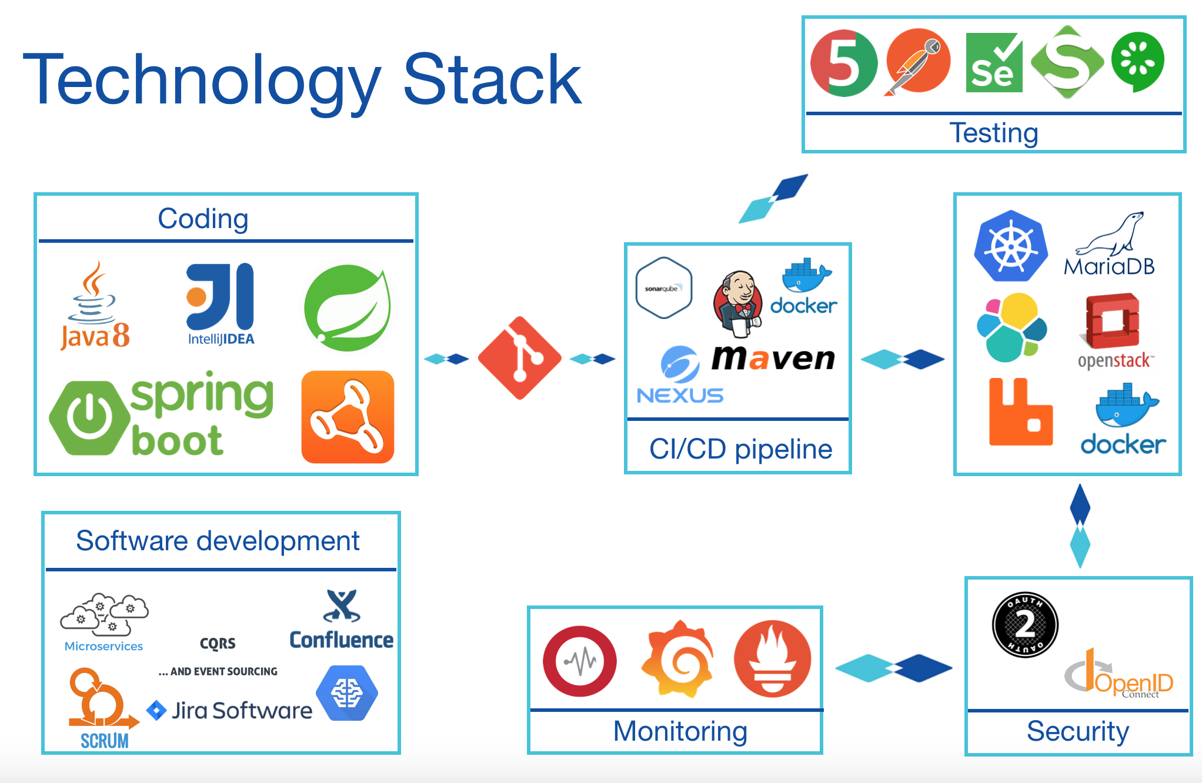
*
Need to Have
Backend
tech stack
Golang / NodeJs, Rust, PHP, etc
In-memory data (Redis, Memcached)
Message Queue (NSQ / Kafka / RabbitMQ)
Standart DDL & DML
Versioning control (Git)
Good Documentation
Nice to Have
Software Architecture Design Pattern (Gang of Four)
Unit Test
You’ll Find
Backend’ Thing (Security, Reliability, & Scalability)
Monitoring (Grafana, Datadog, Vividcortex)
Centralized Configuration (Consul, Vault)

Slide 29
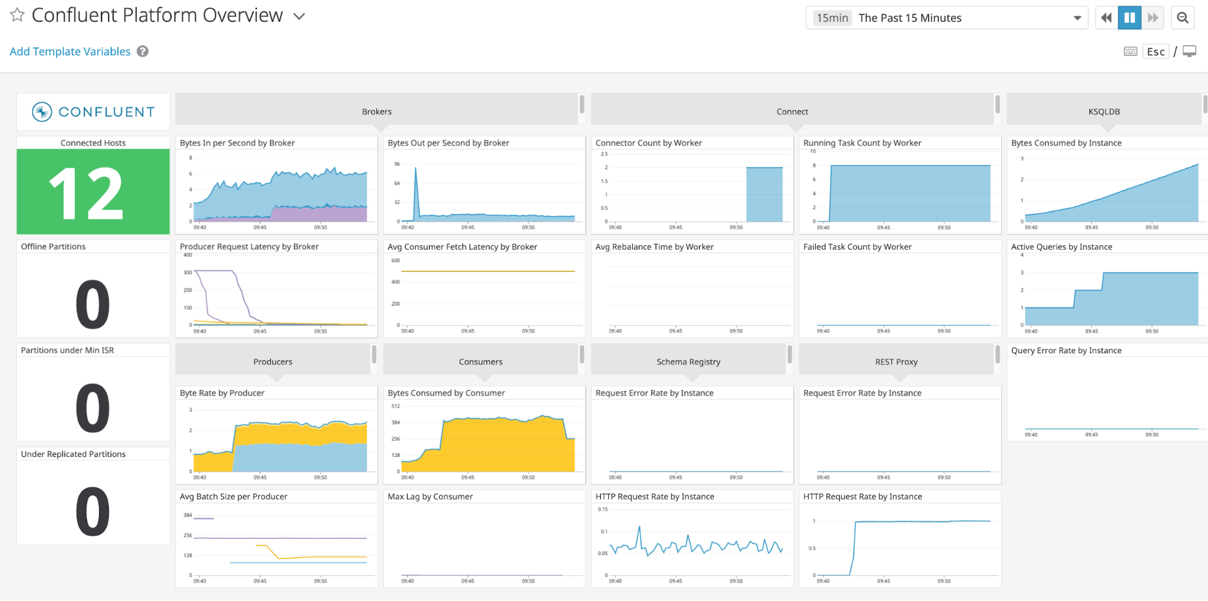



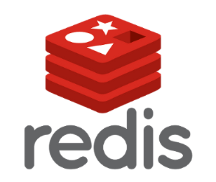
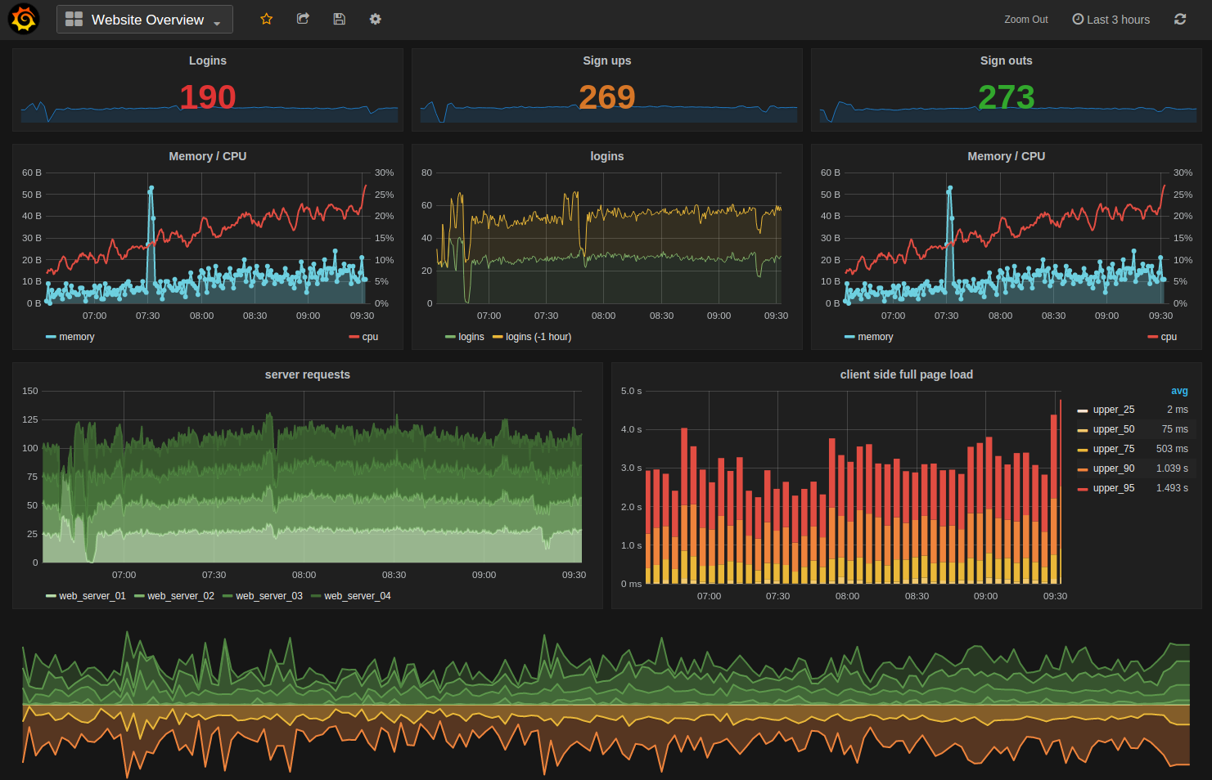





Backend
in Tokopedia
Golang
NSQ

Slide 30
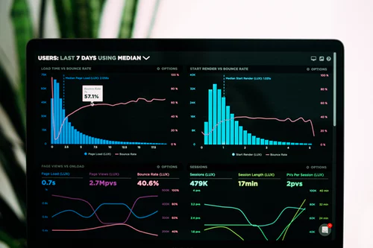
04
Data scientist
Processing, cleansing, and verifying the integrity of data both structured and unstructured data
Analyze large amounts of information to discover trends and patterns
Build use cases such as predictive models and machine-learning algorithms
Design structured, multi-source data solutions to deliver the dashboards and reports that make data actionable

Slide 31
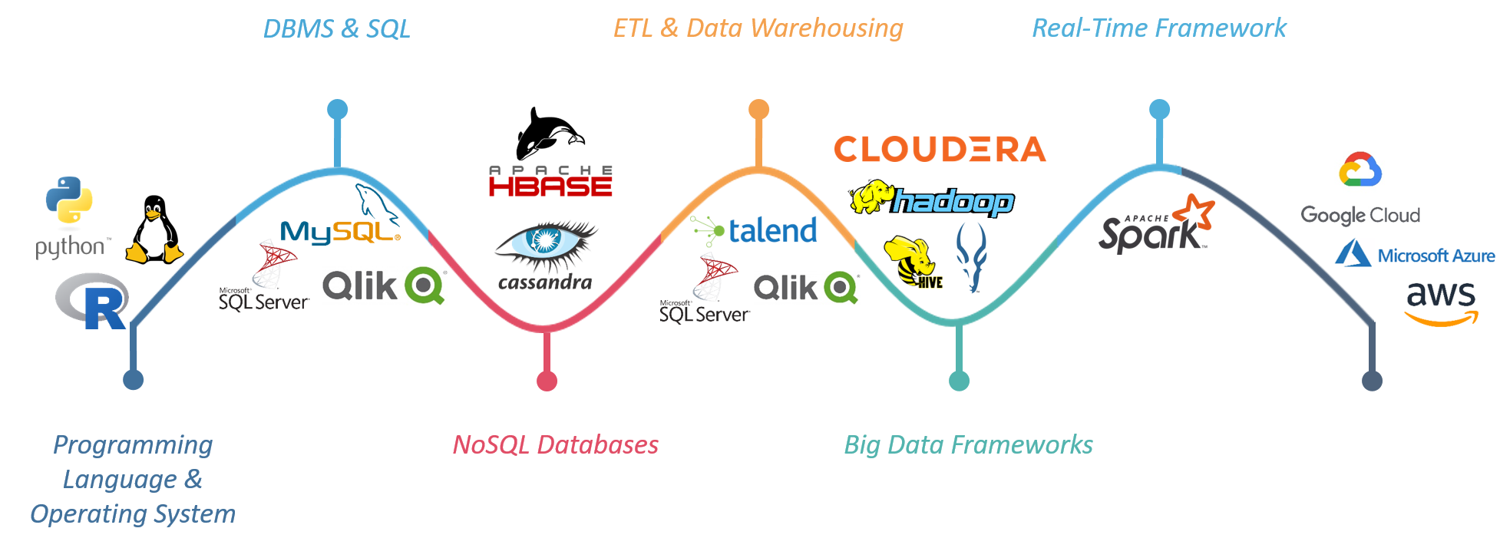
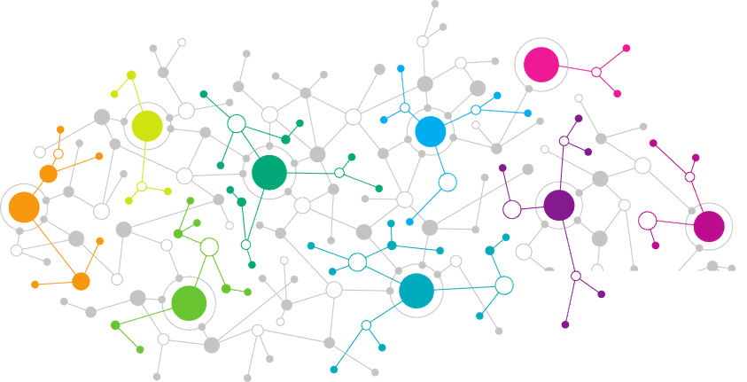
DATA ENGINEER FRAMEWORK

Slide 32
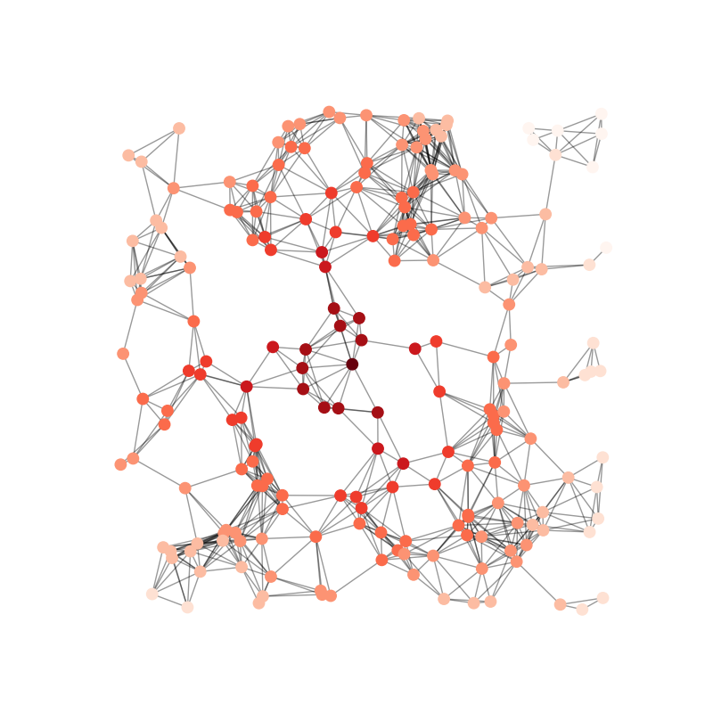
*
Data science
tech stack
Big Data
Machine Learning
Network Analysis
Cloudera
Hadoop
HDFS (Hadoop Distributed File System)
Apache Spark
PySpark
Dask
Impala (Query engine)
Python
Pandas (python lib)
Scikit-learn (python lib)
NumPy (python lib)
NetworkX (python lib)
Gephi (visualization)
FNA (Financial Network Analytics)

Slide 33
Thank you
Lets discuss

